Slide 1



TypeScript Overview
You wanted OOP – now you have it!

Slide 2

Table of Contents
What & Why?
Basic Types
Interfaces
Classes
Modules
Functions
Generics

Slide 3
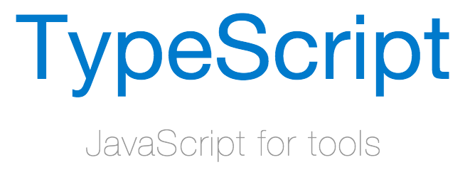
What & Why
Getting ready for TypeScript

Slide 4
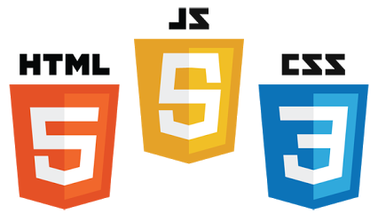
What & Why
TypeScript
Typed superset of JavaScript
Any browser
Any OS
Open Source
Starts with JS, ends with JS
More information here:
http://www.typescriptlang.org/

Slide 5

What & Why
Requirements
Basic JavaScript knowledge
Variables
Functions
Basic OOP knowledge
Classes
Interfaces
Inheritance

Slide 6
What & Why
Live Demo

Slide 7

Basic Types
Types? Where?

Slide 8
Basic Types
Boolean - true or false
String - text
Number – integer or floating point number
Array – collection of types
Object – base object
Enum – enumeration
Any – dynamic types, can be everything
Void – no value

Slide 9
Basic Types
var currentName: string;
var hasPassed: boolean;
var averageMark: number;
var currentCourses: string[]; // Array<string>
var additionalInfo: any;
var currentState: State;
enum State { Onsight, Online, NotEnrolled }
function setStudent(
name: string, passed: boolean,
mark: number, courses: string[], info: any,
state: State) : void {
…
}

Slide 10
Basic Types
Live Demo

Slide 11

Interfaces
Interfaces? Interesting…

Slide 12
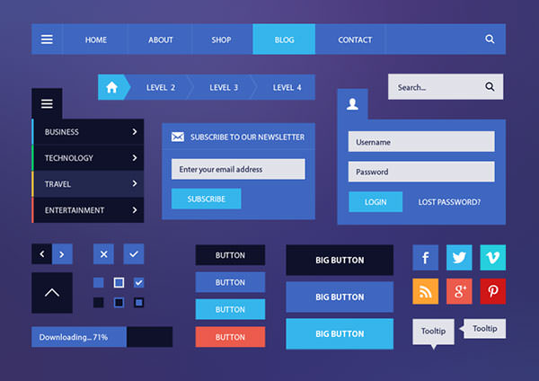
Interfaces
Can define properties
Can define optional properties
Can define methods
Can define functions
Can define indexers
Can extend other interfaces

Slide 13
Interfaces
interface Person {
firstName: string;
lastName: string;
age?: number;
}
interface Driver extends Person {
yearsExperience: number;
vehicles: Vehicle[];
addVehicle(vehicle: Vehicle): void;
removeVehicle(vehicle: Vehicle): Vehicle;
}

Slide 14
Interfaces
Live Demo

Slide 15
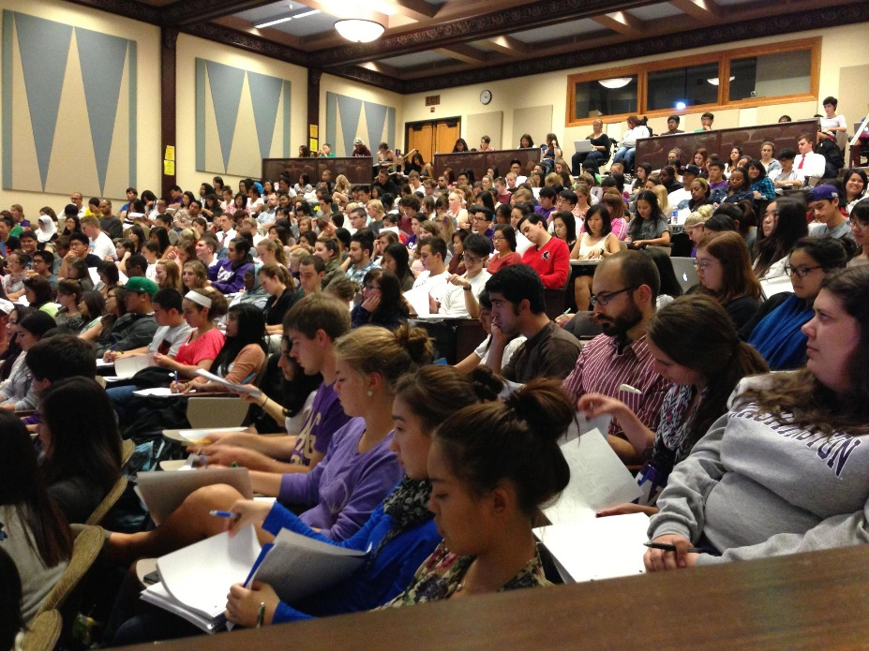
Classes
Classes? Are you sure?

Slide 16
Classes
Can implement properties
Can have constructors
Can have methods
Have this referring to the current instance
Can extend other classes (super is base)
Can define private/public parts
Can define getters or setters
Can define static parts

Slide 17
Classes
class CarDriver extends BasePerson implements Driver {
private static LicenseNumber: string = '1234-5678';
private _health: number;
vehicles: Vehicle[];
constructor(name: string, public experience: number) {
super(name);
}
get health() {…}
set health(newHealth: number) {…}
static CurrentLicenseNumber(): string {…}
addVehicle(vehicle: Vehicle) {…}
greet() : string {
return super.greet() + …;
}
}

Slide 18
Classes
Live Demo

Slide 19

Modules
Modules? You mean namespaces or what?

Slide 20
Modules
Organize your code into subsystems
Created by the module keyword
Define the public parts by export keyword
You can split one module into different files
You can compile them to a single one
Possibility of external modules (node/require)
Can be used with external libraries

Slide 21
Modules
module Drivers {
export class BasePerson implements Person {
…
}
export class CarDriver extends BasePerson {
…
}
}
var someDriver = new Drivers.CarDriver(…);

Slide 22
Modules
Live Demo

Slide 23

Functions
Lambdas? You got to be kidding me!

Slide 24
Functions
Can define the types of the parameters
Can define their return value
Can define typed pointers
Can have optional or default parameters
Can define collection parameters
Can be used as lambda expressions
Can have overloads based on their parameters

Slide 25
Functions
function calculateSum(x: number, y: number, z?: number, ...restNumbers: number[]): number {
var sum = x + y;
for (var i = 0; i < restNumbers.length; i++) {
sum += restNumbers[i];
}
return sum;
}
var calc: (x: number, y: number)=> number = calculateSum;
var calcSum = (x, y) => x + y;

Slide 26
Functions
Live Demo

Slide 27
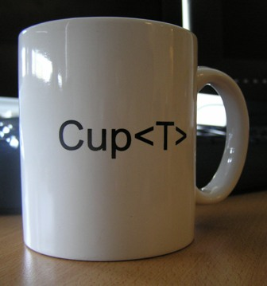
Generics
Generics? Yeah, right!

Slide 28

Generics
Provides reusability
Generic functions
Generic classes
Gives you types checking and constrains

Slide 29
Generics
class List<T> {
private _collection: T[];
add(item: T) {
this._collection.push(item);
}
remove(item: T) {
…
}
get count() {
return this._collection.length;
}
}

Slide 30
Generics
Live Demo

Slide 31

Additional Info
More is better!

Slide 32
Additional Info
Documentation
http://www.typescriptlang.org/Content/TypeScript%20Language%20Specification.pdf
Handbook
http://www.typescriptlang.org/Handbook
Demos
http://www.typescriptlang.org/Samples
Training room
http://www.typescriptlang.org/Playground

Slide 33
TypeScript
http://academy.telerik.com

Slide 34
Homework
* Create a class hierarchy by your choice with TypeScript consisting of the following:
At least 2 modules
At least 3 interfaces
At least 6 classes
At least 2 uses of inheritance
At least 12 methods
At least one generic use
At least one static use
Everything should be strongly typed

